Slide 1
Student Portfolio
^{STUDENT NAME: ANANTHI R.}
REGISTER NO AND NMID: asanm225anm22524132251802522004.
DEPARTMENT:B.SC., COMPUTER SCIENCE.
COLLEGE: GOVERNMENT ARTS AND SCIENCE COLLEGE , VANUR.
^{THIRUCHITTRAMPALAM KOOTROAD}
^{ANNAMALAI UNIVERSITY.}
1
Notes:
<number>

Slide 2
PROJECT TITLE
Student portfolio
1

Slide 3


AGENDA
Problem Statement
Project Overview
End Users
Tools and Technologies
Portfolio design and Layout
Features and Functionality
Results and Screenshots
Conclusion
Github Link
3/21/2024 Annual Review
1

Slide 4

PROBLEM STATEMENT
Many students and beginners find it difficult to showcase their skills, education, and projects in a professional way. Without a proper platform, their talents and knowledge often go unnoticed.
1

Slide 5

PROJECT OVERVIEW
This project is a personal portfolio website created to present my education, skills, and projects in a structured and attractive manner. It works as a digital resume that highlights my learning journey and achievements.
1

Slide 6

WHO ARE THE END USERS?
Recruiters and employers who want to know about my skills
Teachers and professors for academic evaluations
Friends, peers, and project collaborators
1

Slide 7

TOOLS AND TECHNIQUES
HTML, CSS – for frontend development
VS Code – as the code editor
GitHub – for version control and hosting
1

Slide 8
POTFOLIO DESIGN AND LAYOUT
The portfolio follows a simple, clean, and responsive design.
It includes sections such as:
About Me
Education
Skills
Projects
Contact
The design is minimal, professional, and easy to navigate
1

Slide 9
FEATURES AND FUNCTIONALITY
Mobile and desktop friendly (responsive design)
Navigation bar for smooth section access
Professional layout to display education, skills, and projects clearly

Slide 10
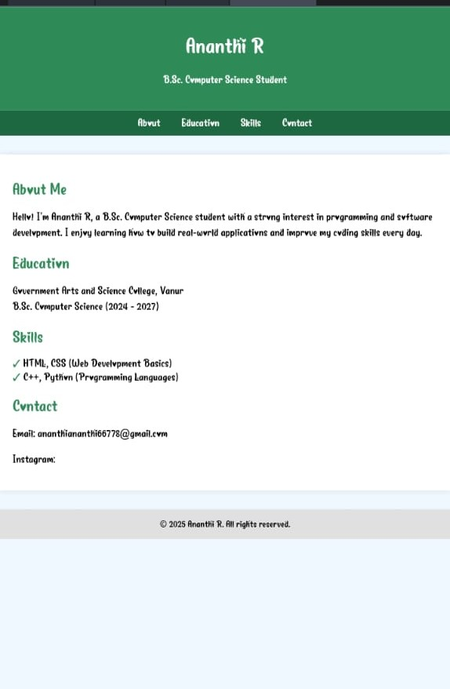

RESULTS AND SCREENSHOTS
3/21/2024 Annual Review
1

Slide 11
CONCLUSION
Building this portfolio helped me improve my web development skills and gave me a professional way to showcase my journey as a Computer Science student.
<number>

